Slide 1
OOP Part 3 Midterm Review

Slide 2
Object-Oriented Programming: Inheritance Review

Slide 3
Learning Objectives
Inheritance allows classes to reuse methods and attributes from a parent class.
super() is a new method in Python
Subclasses or child classes are distinct from one another but share properties of the parent.

Slide 4
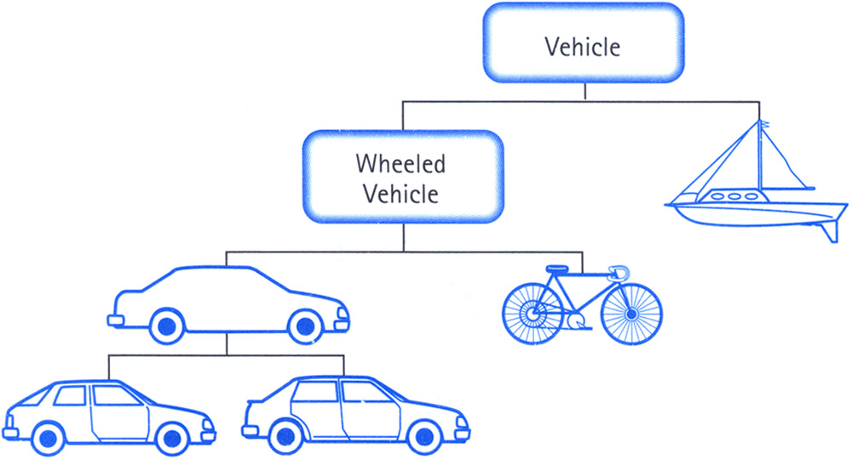
Class Inheritance
Classes can inherit methods and attributes from parent classes but extend into their own class.
“is a” relationship

Slide 5
Inheritance
Define a class as a specialization of an existing class
Inherit its attributes, methods (behaviors)
Add additional ones
Redefine (specialize) existing ones
Ones in superclass still accessible in its namespace

Slide 6
Python class statement
class ClassName:
<statement-1>
.
.
.
<statement-N>
class ClassName ( inherits / parent-class ):
<statement-1>
.
.
.
<statement-N>

Slide 7
Example
class BaseAccount:
def __init__(self, name, initial_deposit):
# Initialize the instance attributes
self._name = name
self._acct_no = Account._account_number_seed
Account._account_number_seed += 1
self._balance = initial_deposit
class CheckingAccount(BaseAccount): def __init__(self, name, initial_deposit):
# Use superclass initializer
BaseAccount.__init__(self, name, initial_deposit)
# Alternatively:
# super().__init__(name, initial_deposit)
# Additional initialization
self._type = "Checking"

Slide 8
Accessing the Parent Class
super() gives us access to methods in the parent or "superclass"
Can be called anywhere in our class
Handles passing self to the method
Handles looking up an attribute on a parent class, too.
We can directly call ParentClass.method(self, …)
This is not quite as flexible if our class structure changes.
In general, prefer using super()!
Outside of C88C, things can get complex…
https://docs.python.org/3/library/functions.html#super

Slide 9
super() and Multiple Parent Classes
In general, super() is "smart"
It tries to find the most correct parent class
Super will search through classes with multiple parent classes, or a long hierarchy of classes
ParentClass is less flexible, but very specific.
Use it if you know you always want the same class to be used.

Slide 10
When Should You Use Inheritance?
Use inheritance to refine the behavior of a parent.
For example, our BaseAccount allows us to overdraft our account.
We might want to protect against this:
class CheckingAccount(BaseAccount):
# (…omitted…)
def withdraw(self, amount):
if self.account_balance() - amount < 0:
return "ERROR: You are not allowed to overdraft a CheckingAccount."
return super().withdraw(amount)

Slide 11
Inheritance & Class Attributes - Warning
Previously, we wrote something like this:
class SavingsAccount(BaseAccount):
interest_rate = 0.02
def accrue_interest(self):
self._balance = self._balance * (1 + SavingsAccount.interest_rate)
What happens when we have a new subclass?
class RetirementSavingsAccount(SavingsAccount):
interest_rate = 0.05
Solution: use self.interest_rate instead, which will look up the appropriate attribute.

Slide 12
Object-Oriented Programming: "Magic" Methods

Slide 13
Learning Objectives
Python's Special Methods define built-in properties
__init__ # Called when making a new instance
__sub__ # Maps to the - operator
__str__ # Called when we call print()
__repr__ # Called in the interpreter

Slide 14
Special Initialization Method
__init__ is called automatically when we write: my_account = BaseAccount('me', 0)
class BaseAccount:
def __init__(self, name, initial_deposit):
self.name = name
self.balance = initial_deposit
def account_name(self):
return self.name
def account_balance(self):
return self.balance
def withdraw(self, amount):
self.balance -= amount
return self.balance
return None

Slide 15
More special methods
class BaseAccount:
… (init, etc removed)
def deposit(self, amount):
self._balance += amount
return self._balance
def __repr__(self):
return '< ' + str(self._acct_no) +
'[' + str(self._name) + '] >'
def __str__(self):
return 'Account: ' + str(self._acct_no) +
'[' + str(self._name) + ']'
def show_accounts():
for account in BaseAccount.accounts:
print(account)
Goal: unambiguous
Goal: readable

Slide 16
More Magic Methods
We will not go through an exhaustive list!
Magic Methods start and end with "double underscores" __
They map to built-in functionality in Python. Many are logical names:
__init__ → Class Constructor
__add__ → + operator
__sub__ → - operator
__getitem__ → [] operator
__repr__ and __str__ → control output
A longer list for the curious:
https://docs.python.org/3/reference/datamodel.html

Slide 17
Announcements & Policies
Midterm:
2 hours, 120 Minutes
Unlimited Handwritten Cheat sheets – More than ~3 is counter-productive
1 CS88 Provided Reference Sheet
Remember: HW6 / Lab 6 due next week, but are in scope.

Slide 18
Midterm Review

Slide 19
You are not your grades!
Do your best!

Slide 20
My Advice
Don't rush!
Slow is fast and fast is slow
BREATHE!
Skim the exam first
It's ok to do questions out of order!
Get the stuff you're good without out of the way
BUT don't spend too much time planning the exam.
Read through the question once
What's it asking you to do at a high level?
What do the doctests suggest?
What techniques should you be using?
Use the scratch space!

Slide 21
Midterm Topics
Everything Through OOP w/ Inheritence
Functions
Higher Order Functions
Functions as arguments
Functions as return values
Environment Diagrams
Lists, Dictionaries
List Comprehensions, Dictionary Comprehensions
Abstract Data Types
Recursion
Object-Oriented Programming

Slide 22
Recursion Review

Slide 23
The Recursive Process
Recursive solutions involve two major parts:
Base case(s), the problem is simple enough to be solved directly
Recursive case(s). A recursive case has three components:
Divide the problem into one or more simpler or smaller parts
Invoke the function (recursively) on each part, and
Combine the solutions of the parts into a solution for the problem.

Slide 24
Recursion Key concepts – by example
1. Test for simple “base” case
2. Solution in simple “base” case
def sum_of_squares(n):
if n < 1:
return 0
else:
return sum_of_squares(n-1) + n**2
3. Assume recusive solution to simpler problem
4. ”Combine” the simpler part of the solution, with the recursive case

Slide 25
Recursion With Lists
Goal: Find the smallest item in a list, recursively.
Consider: How do we break this task into smaller parts? What is the "smallest list"?
We care about the size of the list itself, not the values.
def first(s):
"""Return the first element in a sequence."""
return s[0]
def rest(s):
"""Return all elements in a sequence after the first"""
return s[1:]
def min_r(s):
'''Return minimum value in a sequence.'''
if len(s) == 1:
return first(s)
else:
return min(first(s), min_r(rest(s)))
Base Case
Recursive Case

Slide 26
Questions from Ed

Slide 27
OOP Questions
super() is a method which refers to the parent class of an object.
It returns a special kind of instance of an object.
We can use super() or the class name of the parent class
Private Attributes and Methods:
self.x is "public"
self._x is a convention which means "you shouldn't use this"
self.__x is private. Python prevents other classes from accessing that attribute.
Method calls:
object.method(arguments) is the same as Class.method(object, arguments)
cs88.deposit(5o) vs Account.deposit(cs88, 50)

Slide 28
ADTs
Constructors / Selectors / Operators
help us think about the actions to represent an object.
Abstraction Barrier:
Means that a function does not rely directly on a particular implementation
Should a function return data?
Usually yes! It depends on the goals!

Slide 29
Some Practice Questions

Slide 30
Exam Practice
Spring 22 Q7
Spring 20 Q5

Slide 31
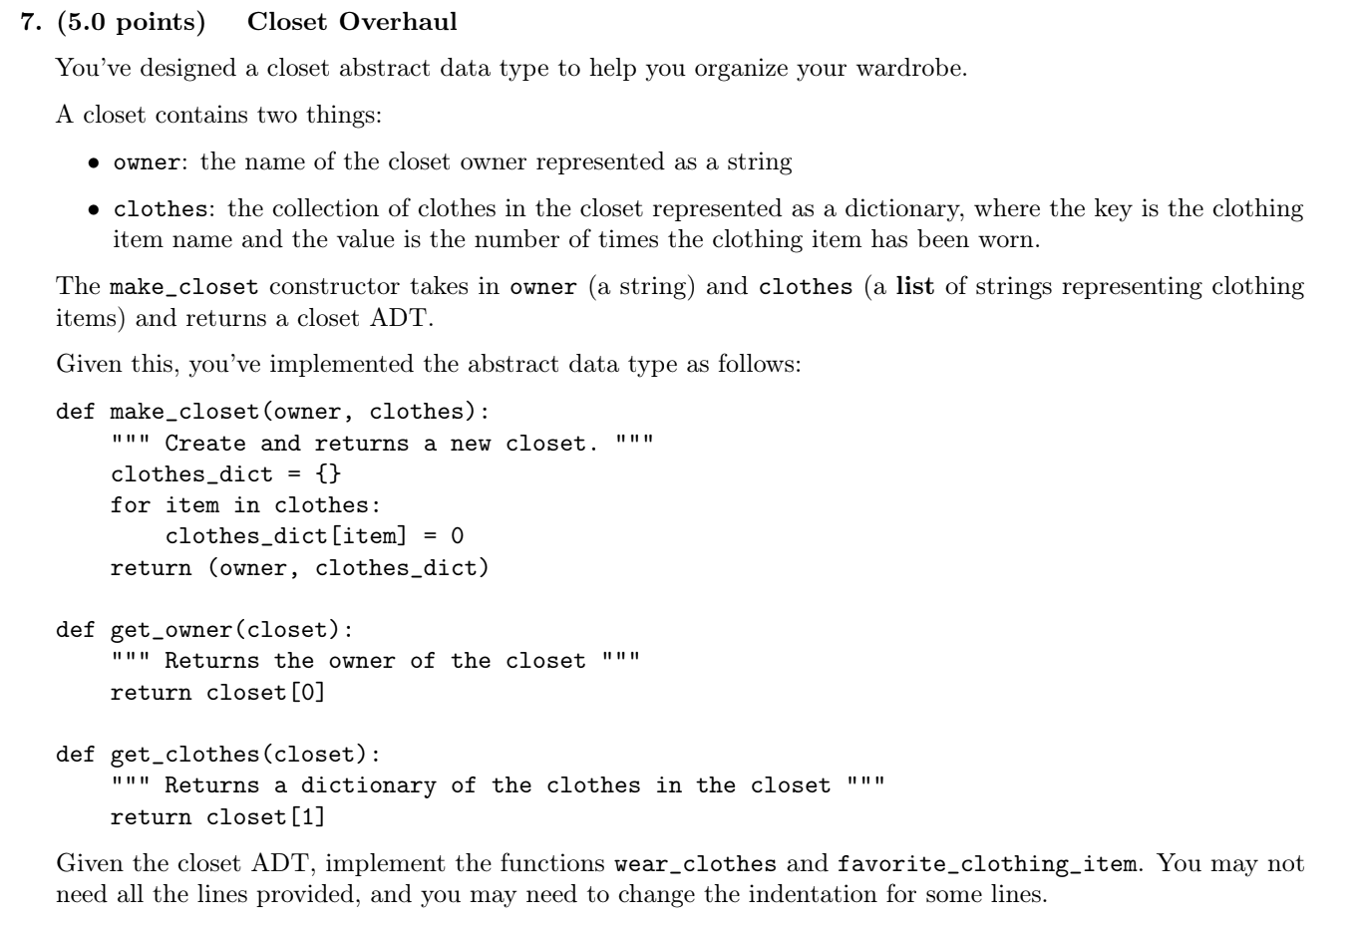
SP22

Slide 32
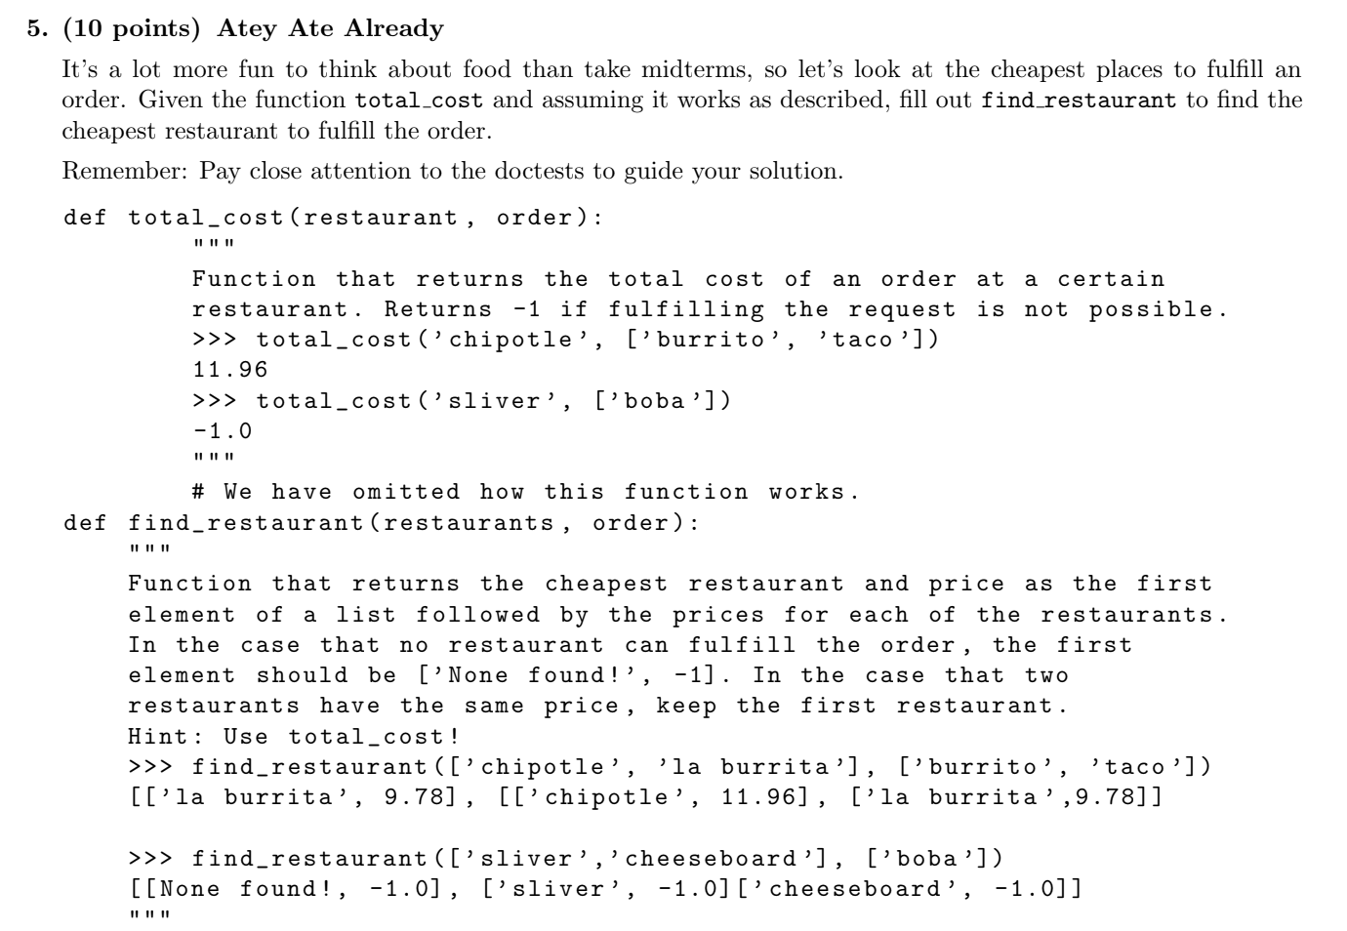

Slide 33
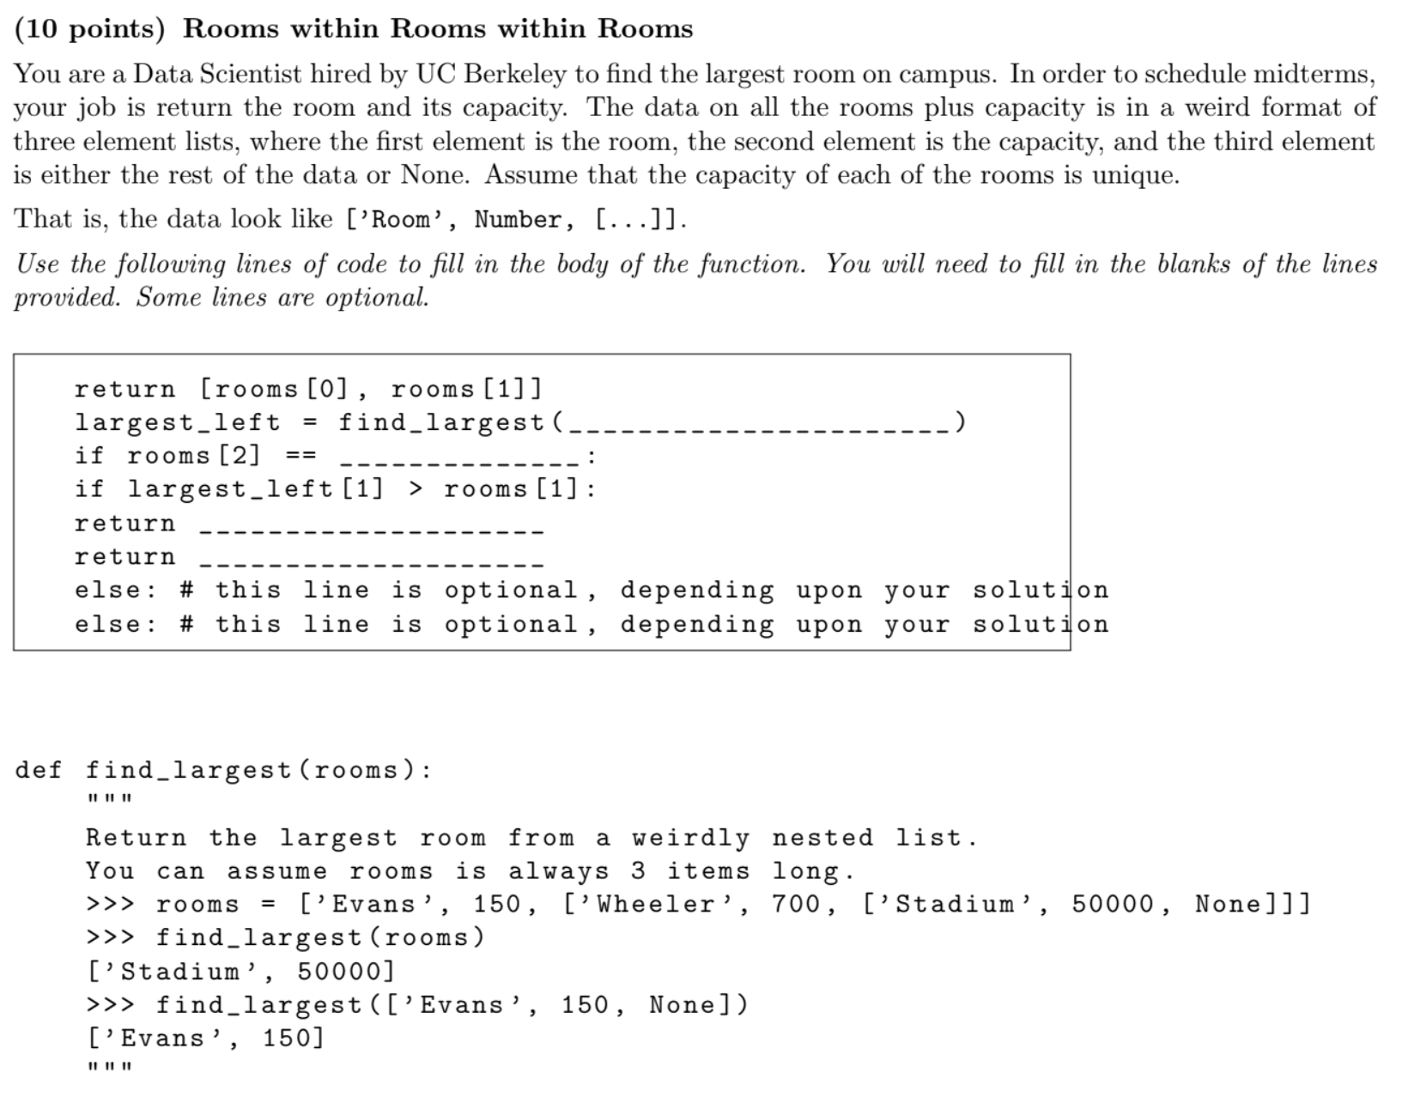
SP20 #6

Slide 34
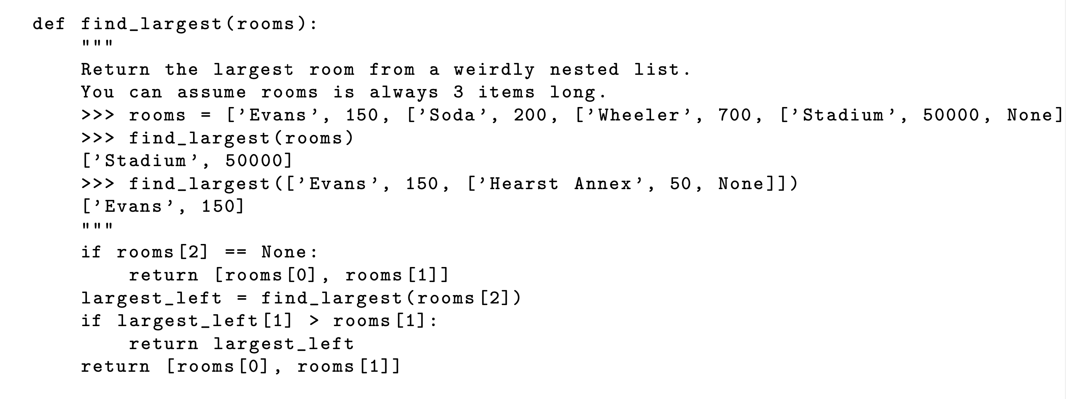

Slide 35
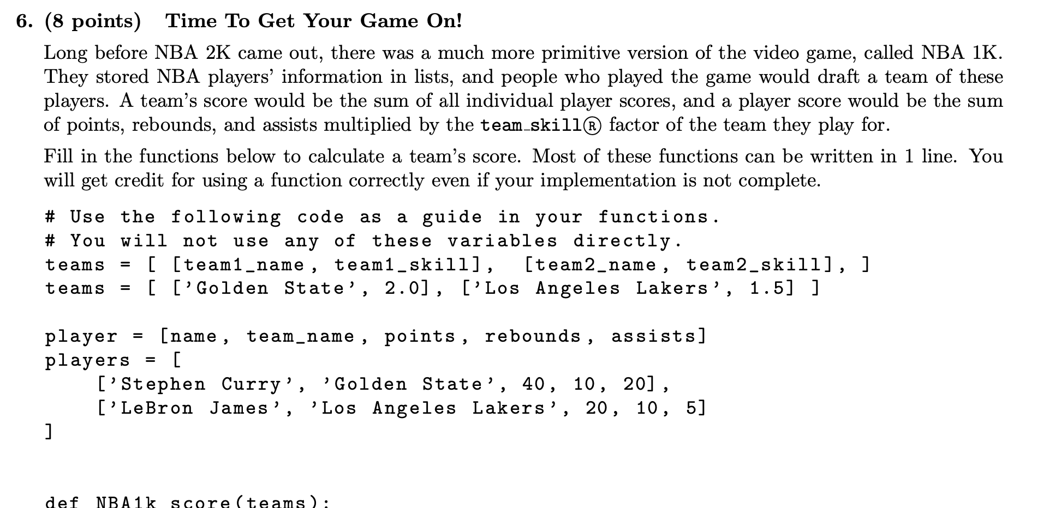
Fall 2019 #6

Slide 37
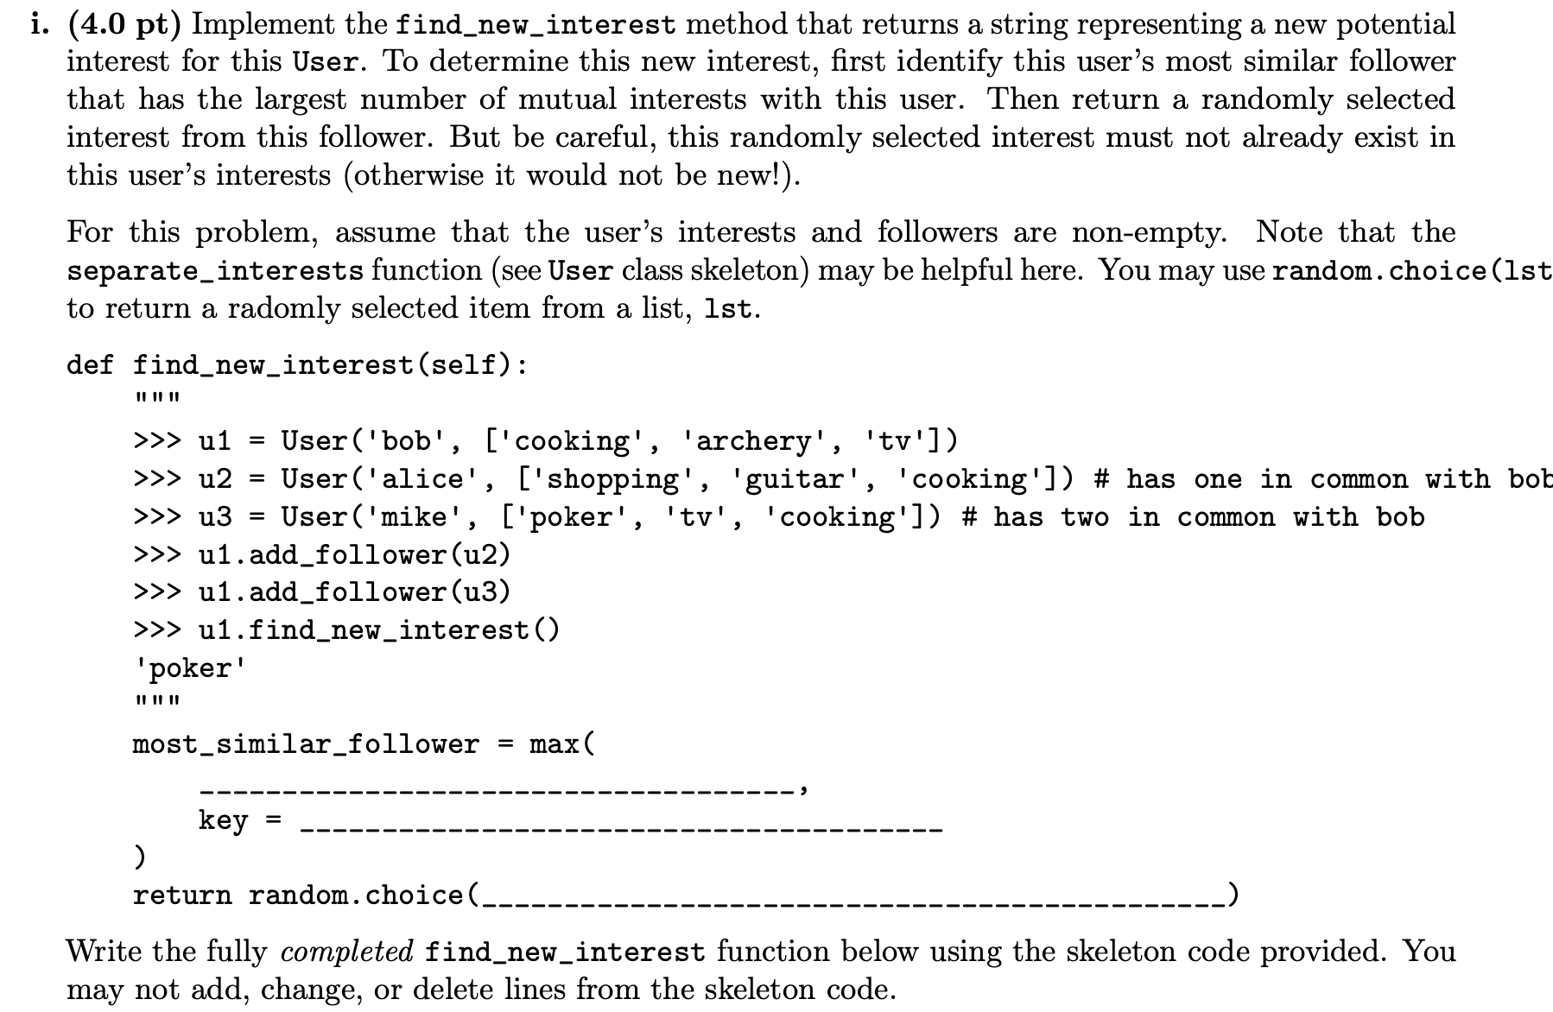
Fa21 8c

Slide 39
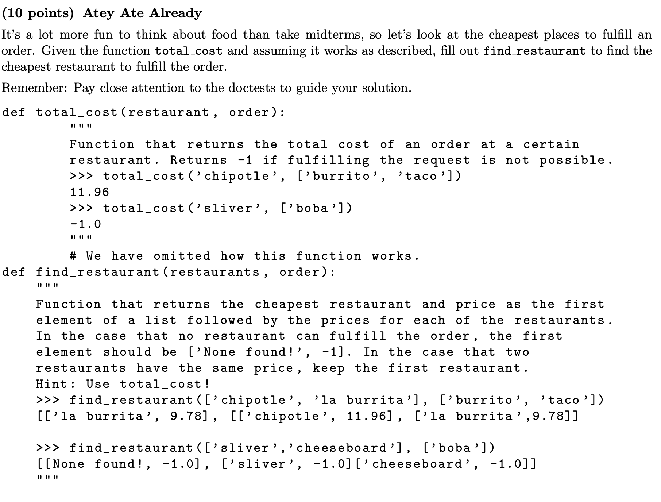
SP20 #5

Slide 40
